Slide 1
Employee Data Analysis using Excel
STUDENT NAME: H.MONIKA
REGISTER NO:312200468
DEPARTMENT: B.COM COMPUTER APPLICATION
COLLEGE:S.I.V.E.T COLLLEGE,GOWRIVAKKAM,CHENNAI-600073

Slide 2
PROJECT TITLE
CREATING AN EMPLOYEE PERFORMANCE SCORECARD IN EXCEL

Slide 3


AGENDA
Problem Statement
Project Overview
End Users
Our Solution and Proposition
Dataset Description
Modelling Approach
Results and Discussion
Conclusion
3/21/2024 Annual Review

Slide 4

PROBLEM STATEMENT
validating employee performance​.
Based on performnce providing increment the employee​

Slide 5

PROJECT OVERVIEW
Analyzing the performance of employee considering. various factor like employee id, gender, performance level, business unit.

Slide 6


WHO ARE THE END USERS?
EMPLOYEE
EMPLOYER
MANAGEMENT
INDUSTRY
ORGANIZATION

Slide 7
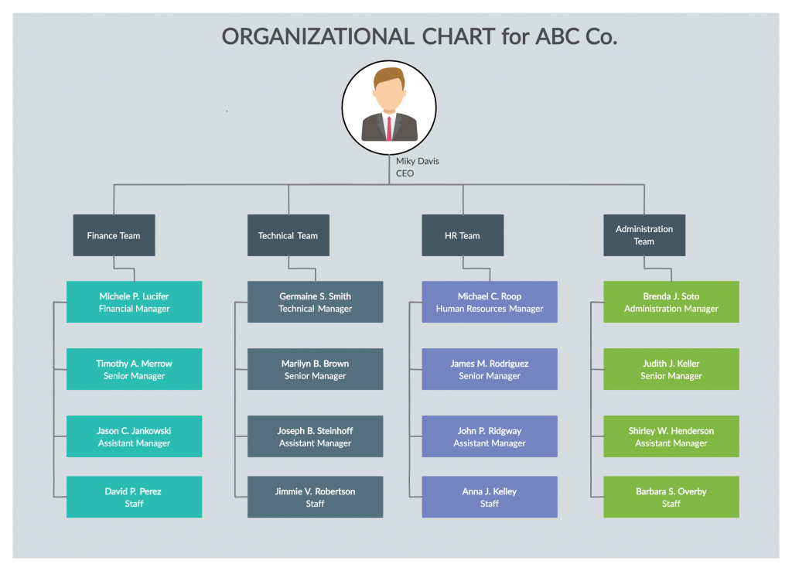

Slide 8

OUR SOLUTION AND ITS VALUE PROPOSITION
Conditional formatting-Highlighted the missing values
Filter-Remove the value
Formula-performance level
=IFD(X2=5,"VERYHIGH",IF(X2=4,"HIGH",IF(X2=3,"MED",IF(X2=2,"LOW",)
Pivot table-summary
(business unit, gender,firstname,performance level)
Graph-data visualization
​​

Slide 9
Dataset Description Employee=kaggle 26-features 13-features Emp id-num FirstName LastName Emp type Performance level Gender-Male,Female Title Supervisor

Slide 10
Business unit​ Employee status​ Employee type​ Employeeclassification​ RaceDesc​ LocationCode
Employee rating-num
Performance level
​

Slide 11
THE "WOW" IN OUR SOLUTION
=IFD(X2=5,"VERYHIGH",IF(X2=4,"HIGH",IF(X2=3,"MED",IF(X2=2,"LOW",)
3/21/2024 Annual Review
11

Slide 12
MODELLING
Data collection :
1.Edunet download
2.Goodwill download
Features:
1.Identifying features one by one
2.What features you will identify
Data leaning:
1.Missing values identify
2.Missing values filter out
Performance level:
1.Calculate which column you will performance
Summary:
1.Pivot table
2. graphs
3.Ppt
12

Slide 13
RESULTS
13

Slide 15
conclusion
1.Download the data employee form Edunet Dashboard.
2.Filter the employee data
3.Created a performance level using formula.
4.In Insert option using pivot table create a table EMPLOYEE PERFORMANCE ANALYSIS.
5.Also create a pie chart graph.

